Slide 1

Restaurant Meal Tracker System
Submitted by:
22BCA10701 - Chido B Chipare
22BCA110707 - Emma P Nkume
22BCA11078 - Velmar T Chinambata
Section: B

Slide 2
Abstract
This project is an Excel-based Meal Tracker system designed for local restaurants to monitor daily plate sales, calculate total revenue based on fixed prices, and visualize dish popularity through charts. It simplifies tracking and improves decision-making for stock and menu management.

Slide 3
Project Objectives
- Track number of plates sold for each meal
- Apply fixed prices to calculate total revenue
- Identify popular dishes using charts
- Provide summaries: Daily, Weekly, Monthly, Yearly
- Enhance restaurant data organization and analysis

Slide 4
Technologies Used
- Microsoft Excel
- Excel Formulas (Multiplication, SUM, LOOKUP)
- Excel Charts (Bar Chart, Pie Chart)
- Data Tables & Summaries

Slide 5
Key Features
- Input interface for meal name, quantity, and price
- Auto-calculation of total revenue
- Fixed pricing mechanism for accuracy
- Dashboard for performance visualization
- Charts highlighting top-selling meals

Slide 6
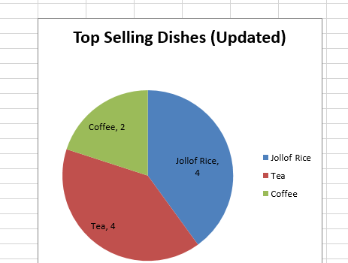
shows top selling

Slide 7
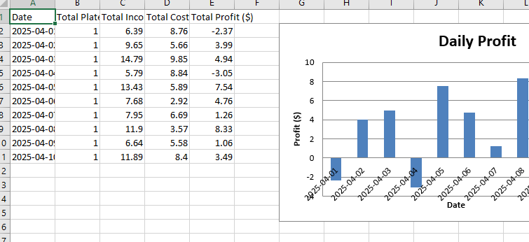
Very detailed

Slide 8
Summarization & Charts
- Summary tables by day, week, month, and year
- Charts automatically reflect trends
- Helps identify peak sales periods and dish demand
- Supports better planning and restocking

Slide 9
.
Summary tables by day, week, month, and year
- Charts automatically reflect trends
- Helps identify peak sales periods and dish demand
- Supports better planning and restocking

Slide 10
Conclusion
This Excel-based Meal Tracker streamlines restaurant record keeping.
With fixed pricing, revenue tracking, and visual dashboards, it helps owners make informed decisions on meal performance and sales trends.
Thank You!

